Slide 1
Used Car Selling Price Prediction
Team Members
Karthik M
Muthu Krishnan L
Sourav Sahu
Udhay Shankar G

Slide 2
Problem Definition
Probem Statement: Predicting the price of used cars to help buyers make informed purchase decision.
Automobile industry is heavily affected by price inflation. Every year new car prices keep increasing and majority of the population are unable to afford a new car which results in increased sales of used cars on a global scale. Thus, there is a need for a used car price prediction system to effectively determine the selling price of the car using data analysis and machine learning.
Currently there are few websites that offers this service, but their prediction method and data collection is not very detailed. Besides, different models and systems may contribute on predicting power for a used cars actual market value. It is important to know their actual market value while both buying and selling.
Due to the ongoing Covid-19 pandemic, most of the people are expected to sell their cars to meet their financial needs. Similarly, most of the customers would opt for used cars rather than brand new cars considering the economic crisis. Our prediction model by using a carefully curated dataset and a detailed modelling will help the sellers to quote reasonable selling price and also the buyers can check the actual market value of the used cars from our results.

Slide 3
Suggested Solution
The proposed solution to the underlying problem is the prediction algorithm that enables both the sellers and buyers to understand on what features the price is predicted.
Data Description
Categorical columns: Maker, Model, seller_type, owner_type, fuel_type, transmission_type.
Numerical columns: Max new price, Min new price, Age, km_driven, mileage, engine, max_power, seats, selling_price.
Dataset Enhancement
We have added 3 more columns that supplement the dataset. The columns are derived from dataset.
Age(int): The age of the car is calculated using difference between current year and year of make.
Min new price and Max new price(int): The features ‘Max new Price’ and ‘Min new price’ is extracted from the feature ‘New price’.

Slide 4
Alternate Datasets Considered
We analyzed multiple car datasets from various resources such as Autocar, ZigWheels, Carwaale, UCL Automobile dataset. But we selected CarDekho dataset because of its wide range of features and large collection of car makers and models (20026 rows and 15 columns). This dataset also provided important car specifications such as Fuel Type, Transmission Type and Horsepower.

Slide 5
S.No | Columns | Datatype | Description
1. | Selling_price | float | Current selling price of used car
2. | Seller_type | object | Type of sellers
3. | km_driven | float | Kilometers driven by the car
4. | Owner_type | object | Type of owner
5. | Fuel_type | object | Type of fuel
6. | Transmissio_ type | object | Manual/Automatic
7. | Mileage | float | Mileage of car
8. | engine | float | Engine in cc
9. | Max_power | float | Max horsepower
10. | seats | float | Number of seats
11. | Maker | object | Brand of car
12. | Model | object | Name of car
13. | Min new price | float | Minimum price of car
14. | Max new price | float | Maximum price of car
15. | Age | float | Age of car from year of purchase

Slide 6
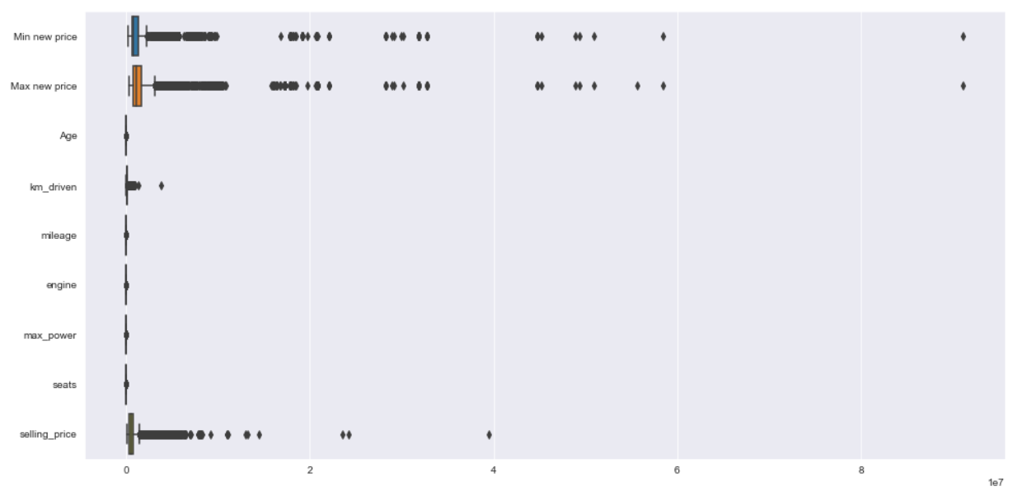
Exploratory Data Analysis
Extreme value treatment:
In the dataset, we had price range from 1 lakh to 8 crores, we dropped the data pricing more than 1 crore.

Slide 7
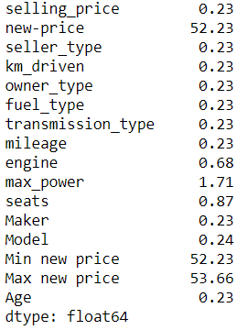
Null Value Imputation
Null value imputation:
We find that three numerical features have null values, with ‘Min new price’ and ‘Max new price’ having more than null values of 50%.

Slide 8
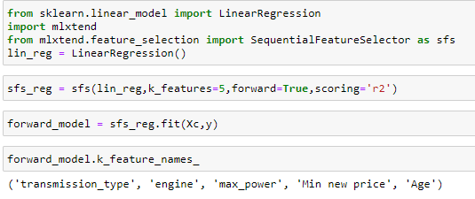

Decision Making on Derived Min-Max Price Missing Value Imputation
The model created without considering the null values in features Min-Max Value had a row count of 9187 and had a p-value of <0.05.
Hence it was inferred that the features had a great impact on the selling price and the values were imputed manually.
It was observed from the forward selection feature limiting to top 5 features, the Min new price feature will be a good predictor in predicting the selling price.
Post the Null-Value imputation based on the skewness of data, with respective treatments, we found our dataset to be void of null values

Slide 9
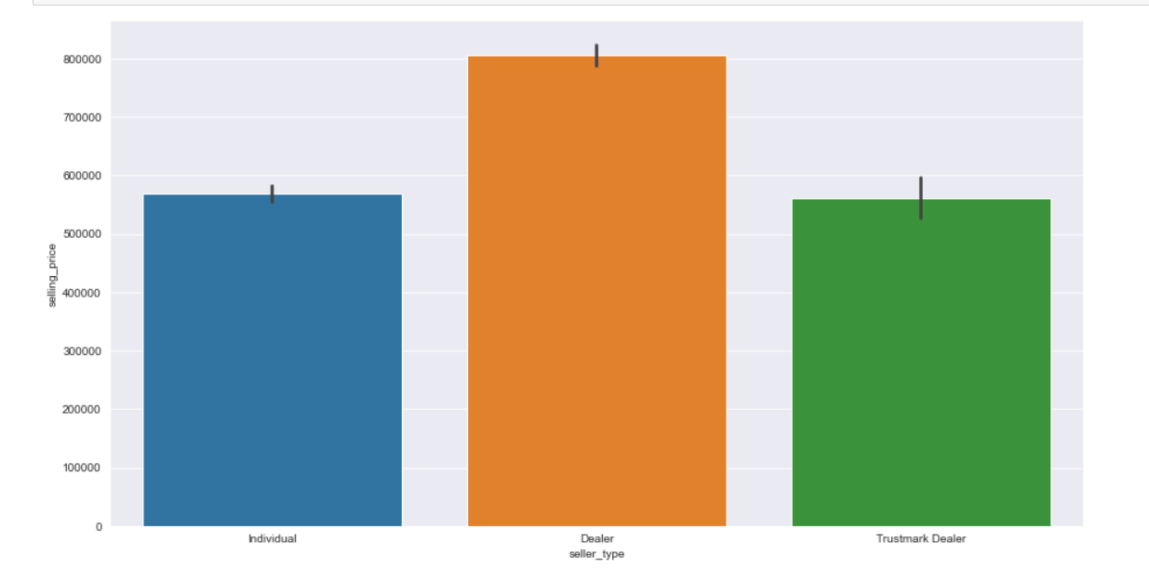
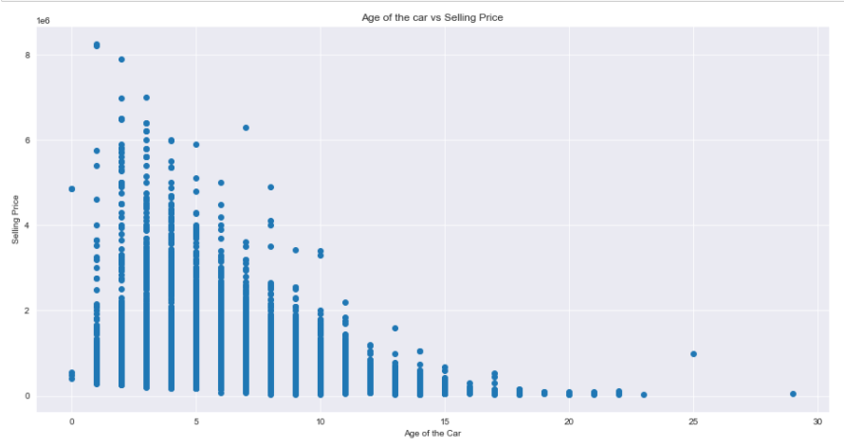
Bi-Variate Data Analysis
In the comparison between Age of the car and selling price, it was inferred that as the age of the car increases the selling price decreases.
In the comparison between seller type and selling price, it was inferred that the dealers were selling the used cars at the highest rate than any other sellers.

Slide 10
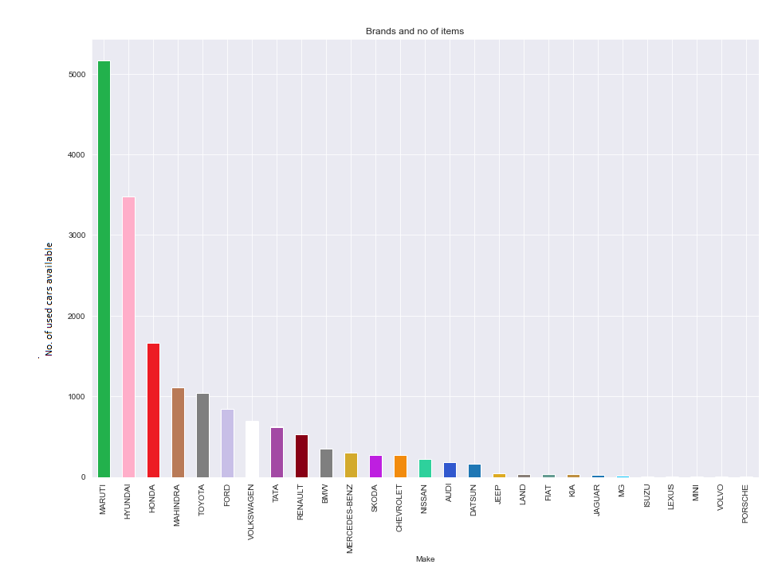
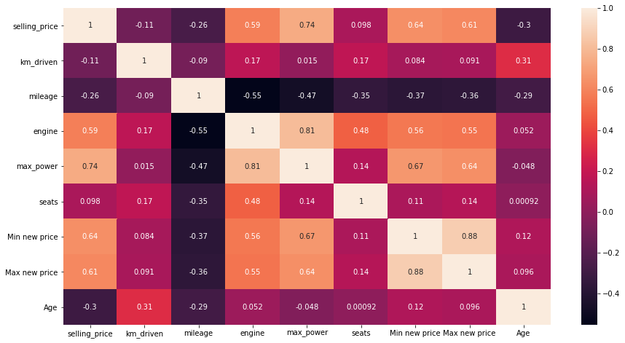
Make Vs Number of used cars available
Multi-collinearity
From the available data we can infer that Maruti, Hyundai and Honda are the makers with highest number of used cars sales.
Customers looking for used cars will have more options available in Maruti, Hyundai, Honda.
From heatmap we infer the following:
The feature ‘Selling Price’, ‘Engine’, ‘Max power’, ‘Max new price’, ‘Min new price’ are highly correlated with each other (more than 0.5).

Slide 11
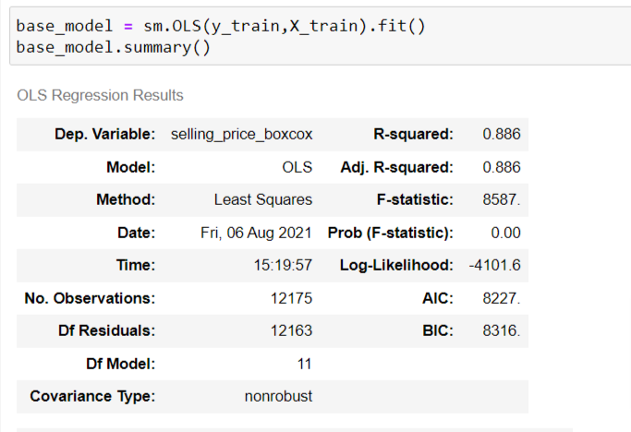
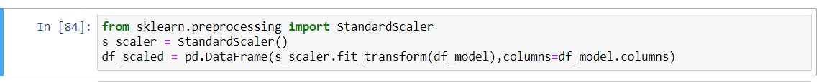
Algorithms, Solution and Conclusions
Algorithms considered:-
As our Target variable (selling price) is a continuous variable, we have decided to Build a base model using Linear Regression.
Base model results:
We also used Lasso Regression model for selecting the best features to build the model.
We performed scaling on our dataset using Standard Scaler.

Slide 12
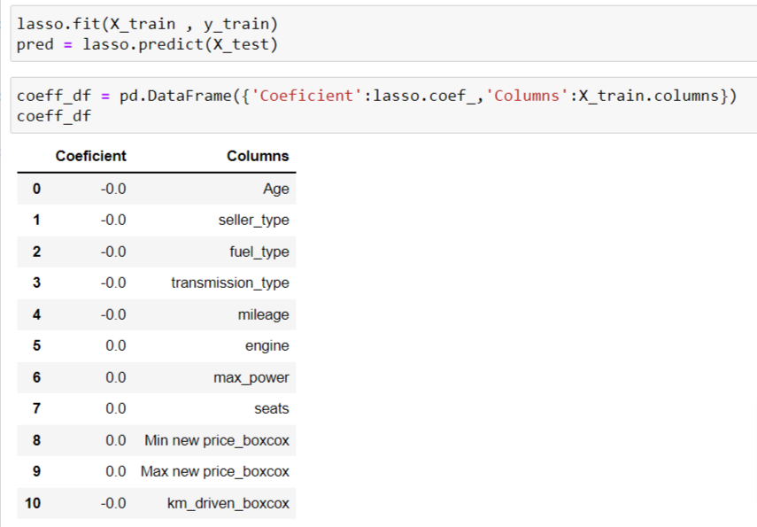
Lasso Regression Model
The best params that are found based on the lasso regression are :
1.Age
2.Seller Type
3.Fuel Type
4.Transmission type
5.Mileage
6.Max power
7.Seats
8.Min new price
9.Max new price
10.KM driven
The model should be developed from these features for getting the best fit if there occurs no descripencies within the data

Slide 13
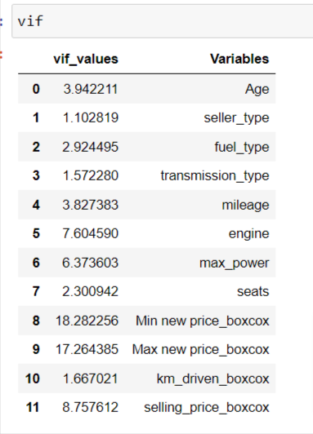
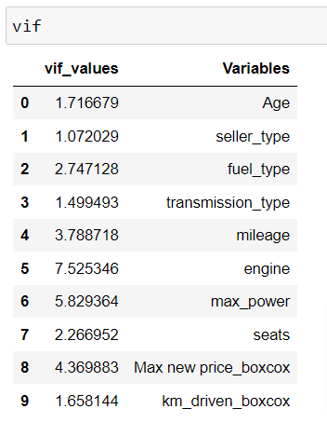
When calculating VIF for the base model, we found ‘Min new price’ and ‘Max new price ‘where highly multi-collinear. Also the p-values > 0.05 for ‘Min new price’ feature. So we decided to drop the ‘Min new price’ feature in our model building.
Pre-Treatment VIF values
Post-Treatment VIF values

Slide 14
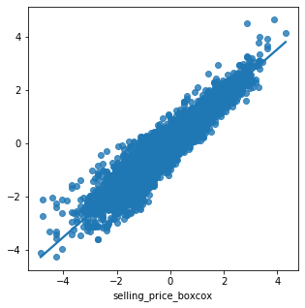
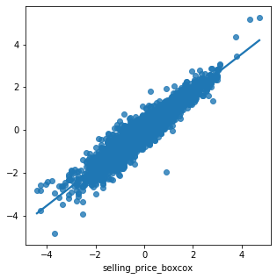
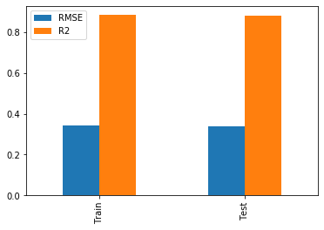
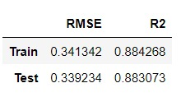
Final Model Results
Train set fit
Test set fit
RMSE and R2

Slide 15
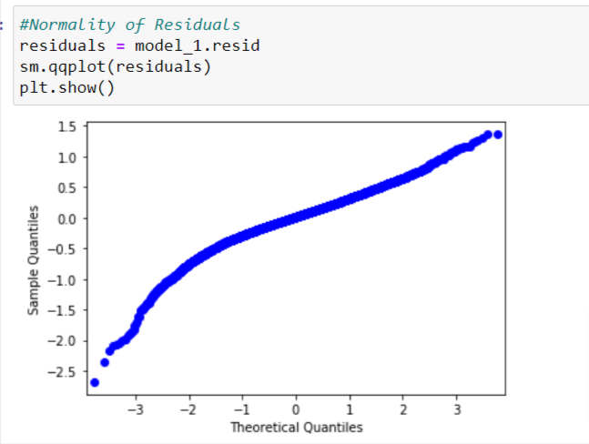
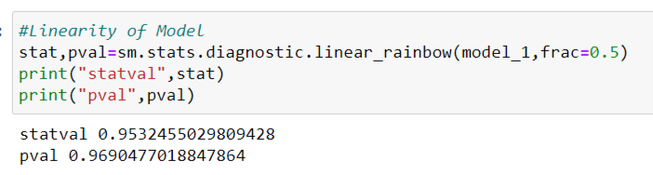
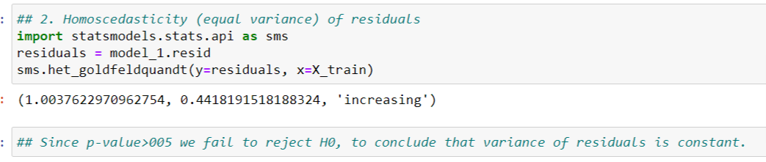
Testing Assumptions

Slide 16
Conclusion
From the model developed the price of the selling car can be determined as :
selling_price = (-0.49) * Age + (-0.06) * seller type + (-0.06) * fuel type + (-0.09) * transmission type + 0.04 * mileage + 0.08 * engine + 0.24 * max power + 0.05 * seats + 0.37 * Max new price + (-0.02)*km driven
The selling price of the car increases based on :
1.Mileage of the car
2.Engine capacity
3.Max power
4.Number of seats
5.Max new price of a new car
The selling price of the car decreases based on :
1.Age of the car
2.Seller type
3.Fuel type
4.Transmission type
5.KM driven

Slide 17
Thank You!

